Slide 1
Welcome! SSLC Course Rep Training 2017

Slide 2
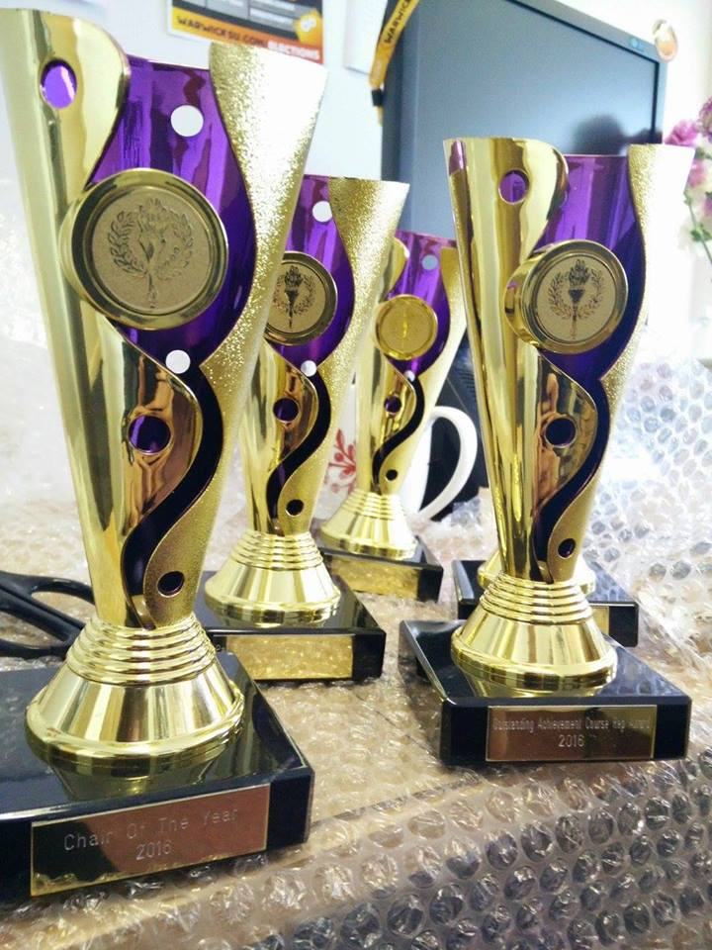
Objectives
What you do as a course rep
Where course reps fit in at the SU
Creating effective change
Equipping you with knowledge, skills and support
Notes:
This online training will cover,
Your role and responsibilities as a course rep
Introduce you to the SU and how we support you
How to create effective change
Please do not feel limited to the slides, if you have any questions, please contact Maisie or Nathalie

Slide 3
You are part of the SU!
“Positively impacting students' lives at Warwick and beyond”
Democratically run
Charity
Our Outlets fund:
Democracy
Academic representation (you!)
Campaigning: local, regional and national
Opportunities: jobs & volunteering
Student Advice Centre
Over 300 sports clubs and student societies!
GET INVOLVED! ☺
Notes:
As a student at Warwick, you are automatically a part of the SU – there is no joining fee!
The main principles of the SU are, it is independent (a separate body from the University), a charity (all the money spent in SU outlets goes back in to fund student activities), and a democratic organisation (the students elect full time and part time officers to represent the student body in the Autumn and Spring elections).
Though you might not spend time physically on campus, we want you to feel included and please do visit the website https://www.warwicksu.com/ and let us know if you are interested in getting involved with more! We can help ☺

Slide 4
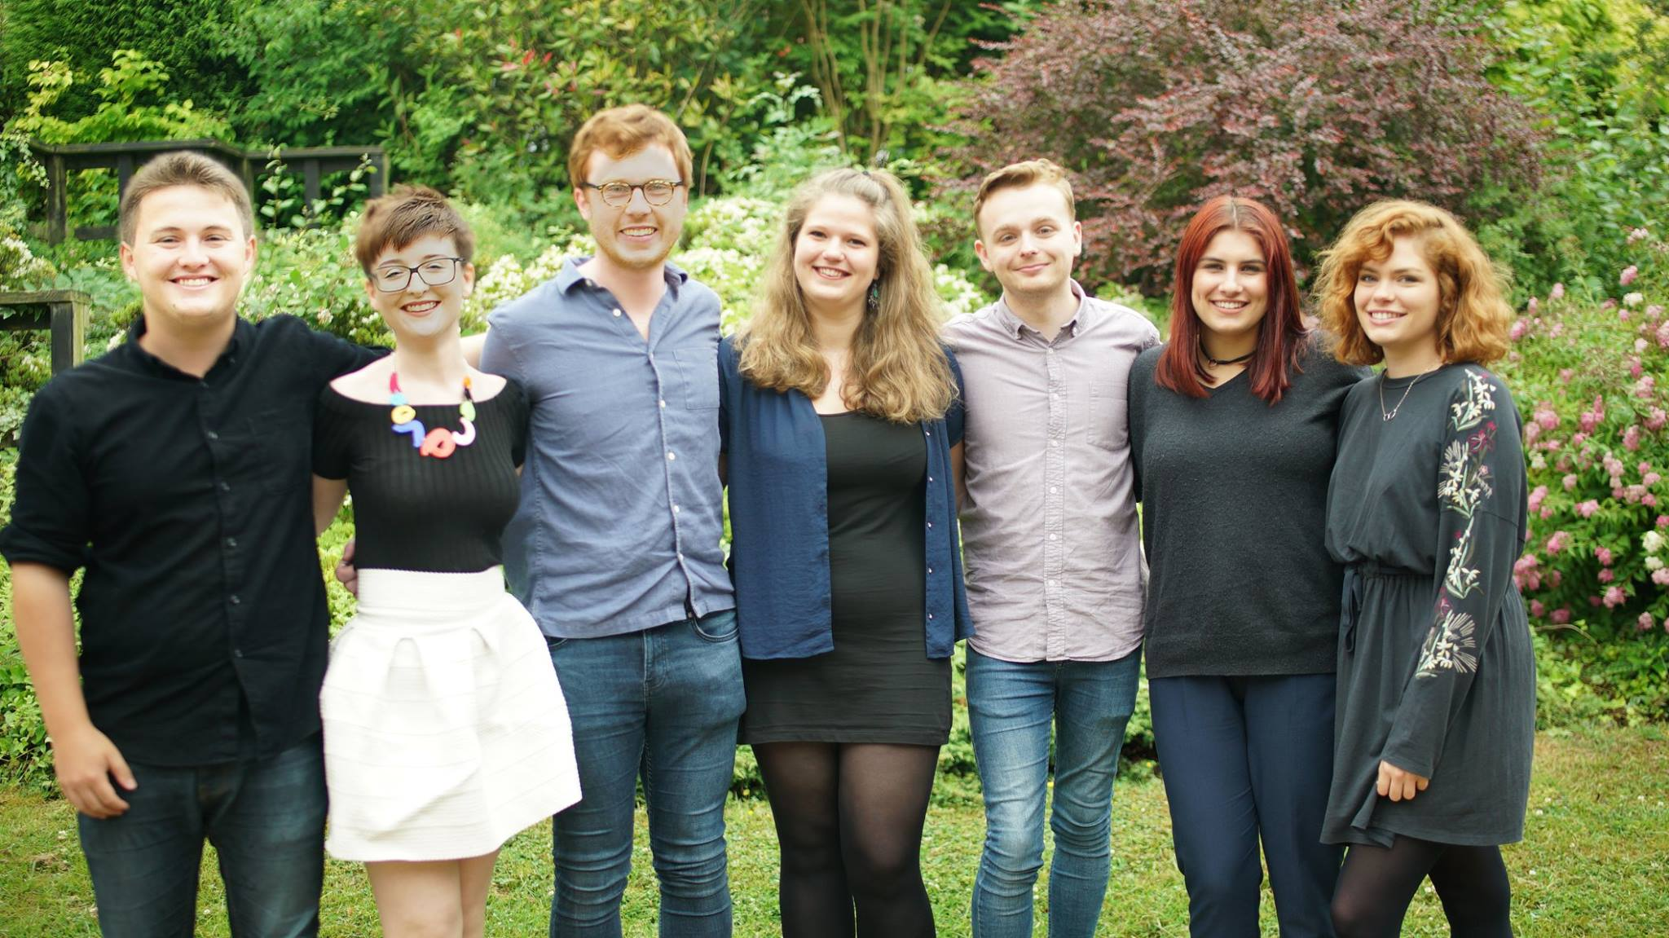
Your Sabbatical Officers!
Notes:
Your Sabbatical officers were elected in the February 2017.
Michael Kynaston – Democracy & Development
Emily Dunford – Postgraduate
Niall Johnson – Societies
Hope Worsdale – President
Liam Jackson – Education (responsible for SSLCs and course reps)
Ellie Martin – Sports
Ellen Holmes – Welfare and Campaigns

Slide 5
Notes:
You may have heard that #WeGetConsent, is one of Warwick SU’s major campaigns at the moment.
This is also in combination with online consent training via moodle which every student and staff member can access.
Here is the video….
It is an important campaign for all reps to be aware of

Slide 6
Sabbs
Faculty Reps
Course Reps
Education and Postgrad Execs
Notes:
Where do you fit in?
This diagram represents the structure of representation at Warwick SU. Course reps are at the bottom as they are the largest (approximately 700 reps across Warwick), they feed into the faculty reps (approximately 12) who sit on the Education and Postgrad Execs. All these mechanisms of representation feed into the sabbatical officers’ work and helps them democratically represent students.
You should invite your faculty reps to all SSLC meetings, they should attend a couple of meetings a year, unless their presence is required at a specific meeting which should be highlighted to them. Please contact us if you don’t know who your faculty rep is.

Slide 7
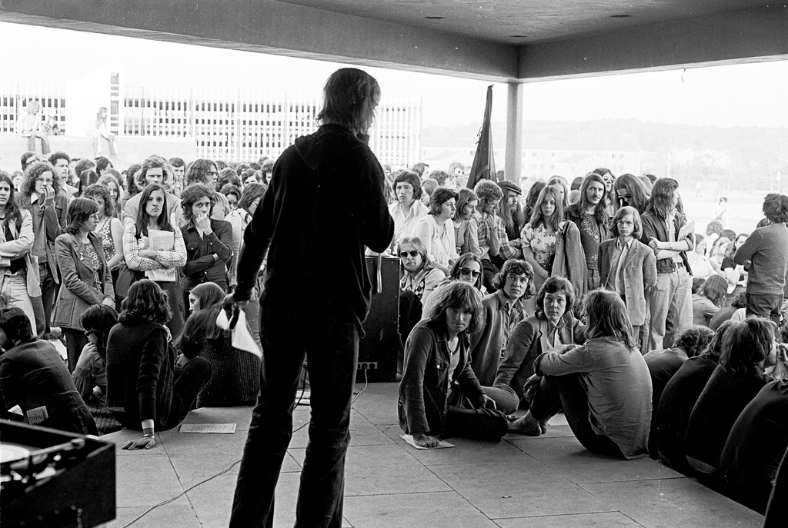
History of academic representation
Notes:
All students are represented on Student-Staff Liaison Committees (SSLCs), which have been an integral part of the University since the early 1970s. (They were introduced in response to student protests and sit-ins which demanded, amongst other things, greater democracy and more involvement for students in decision-making.)
You are now a part of Warwick history!

Slide 8
What is the SSLC?
Forum for lobbying depts./faculties/university
Student & staff collaboration
Campaigns
Democracy in
action
Student led!
Notes:
An SSLC is made up of these key principles, above everything the SSLC must be student led (with reps collecting feedback from their cohort) and allow collaboration between staff and students

Slide 9
Key Education Campaigns
Departmental Issues: (course related) | Faculty/University Issues: (beyond just individual courses) | National Issues: (Country-wide Higher Education issues)
Needs (which may not relate to teaching & learning) specific to students of department Teaching hours Issues with joint-degree programs Office space Hidden course costs | Assessment and examination Liberated curriculum Wednesday afternoons free Personal Tutor System Bursaries | Higher Education Act Tuition fees PGT/PGR loans Issues affecting international students (Brexit, Tier 4 Visas)
Notes:
We have listed above the key education campaigns that are relevant to students on a departmental (course), university and national level.
These can be brought up at your SSLC (no matter the size) and discussed as to how this affects your cohort.
If you have any questions about these campaigns please contact us.

Slide 10
How does the SSLC work?
You will work with students from your cohort to gain their feedback about teaching, learning and student support throughout the year.
SSLCs meet a minimum of 4+ times a year
The Chair and Secretary will take the lead and administrate the meetings (look out for specific online training!)
There is an Academic Convenor who is the staff representative.
Notes:
The chair should be invited to departmental meetings to represent the student voice and discuss these issues at the SSLC

Slide 11
As a course rep……
What challenges might you face in your role?
Think about:
Is your SSLC well organised?
Are the meetings being chaired effectively?
Is your SSLC student-led?
Are staff engaging with your SSLC?
Is communication effective outside of meetings?
Are you helping to create effective change?
How can these issues be resolved?
Notes:
Ask for help/advice from your peers. Talk it through
Contact academic representation/sabbs for advice (Maisie or Liam ☺ )
Contact relevant staff directly
Be proactive and enthusiastic

Slide 12
Before the Meeting
Getting students’ views and gathering opinions, questions and matters for discussion – this can include positive feedback or course issues.
Liaising with other reps in your department
Setting up a meeting (chair/secretary)
Reading & circulating the documents!
Notes:
When gaining feedback from students and adding items to the agenda, there is one main rule to abide by – DO NOT refer to students or staff members by name. You can replace this by generalised name of module names/codes.
Think about possible constructive, creative solutions before attending the meeting, so you are not simply stating a problem without thinking of how to solve it/improve the situation.
As reps you need to work together to get across problems in meetings, back each other up, corroborate with evidence.

Slide 13
Effective Communication
Chat to students and LISTEN!
Social media
Surveys
Lectures
Emails
Notes:
How can you effectively gain feedback from you peers:
Listen to what your fellow Students have to say and encourage them to contribute their ideas and become actively involved in the meetings. Be flexible in your approach to communicating with others, some students may prefer to speak in private and others will be happy to chat in a group. Communication is a 2-way thing!
Anonymised surveys are a tool for getting their views – use the answers in the meetings and publicise the results for the other students to read. Keep the survey simple - don’t over-complicate it!
Emails: e.g. we know of some SSLCs that have set up a dedicated email for feedback purposes.
Academic convenors could also send a mass email to the cohort on behalf of the SSLC
Note: Social media – ensure that it is accessible to all the cohort and not exclusive.
Other methods of communication:
Notice boards, dedicated “office” hours
This list is not exhaustive.
TACTICS to try and reach everyone – think outside the box
ALSO: Publicise your successes!!!! So other Students know when things have been sorted.

Slide 14
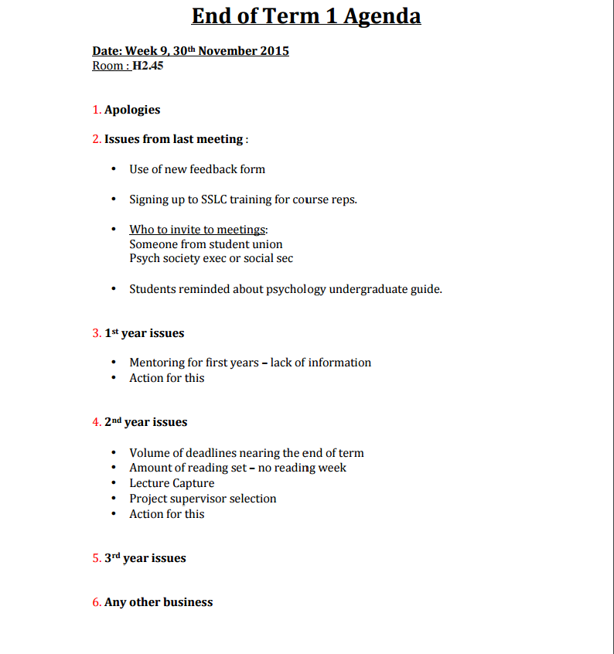
Notes:
After gathering students’ views you should input into the meeting agenda (collated by the SSLC secretary). Make sure you take a look in advance in preparation for the meeting.
We would encourage you to have #wegetconsent on your agendas in an ongoing effort to publicise the campaign and encourage participation in online training.
Equality and Diversity should be a standing agenda item for at least one meeting during the year and compulsory training will be available in January. Dates tbc.

Slide 15
Signposting
Personal tutor
SU advice centre
Mental health and wellbeing team
Student careers and skills
University counselling service
Warwick accommodation
University health centre
University student support
Notes:
Sometimes you may be approached by student who come to you for advice regarding issue outside of your remit as course rep. For example, it is not within your role to solve personal issues, however you can direct them to an appropriate forum.
So it is worth knowing the services that are available to students. Most are self-explanatory
For example:
Personal academic issues (e.g. failed modules) → go to SU advice centre or personal tutor
Accommodation issue (e.g. removal/eviction) → Warwick accommodation
Concern for a friend or feeling overwhelmed at university → advice centre/counselling services/health and wellbeing

Slide 16
During the Meeting
The appointed Chair will take the lead and ensure the meeting is run smoothly, fairly and efficiently.
The Secretary will take the minutes.
Course reps should:
Listen
Support
Contribute
Represent
https://www.ted.com/talks/celeste_headlee_10_ways_to_have_a_better_conversation#t-815
Notes:
The Chair and Secretary are students who have been elected from the course reps.
The chairperson of a committee is responsible for the smooth running of meetings, allowing all members to have their say, whilst ensuring all necessary business from the agenda is covered.

Slide 17
After the Meeting
The minutes are circulated for approval and uploaded to the SSLC Portal.
Feedback to students!
Notes:
Permission of everyone in attendance at the meeting that they agree to the minutes being uploaded online.
We need the correct Chair(s) and Secretary details, who will then be able to update the Portal with Minutes, Agendas and Meeting times as seen here: http://www.warwicksu.com/sslc/

Slide 18
SSLC Portal Info
Each SSLC has a page for the chair/secretary to upload the agendas/minutes and meeting times. This enables you to share ideas and access minutes from all across the University.
It is crucial that we have accurate contact details for all course reps at the beginning of the year to ensure you can all use the SU SSLC Portal.
Notes:
Please double check your portal page and let us know if that needs updating

Slide 19
Scenario 1
(Student talking to a rep):
“I just found out via the departmental secretary that they are scrapping a 15 CAT module in term 2 that I was planning on taking!”
Solution:
Bring this to the SSLC, ask the department for clarification. If this is true, the department needs to explain the reasoning. How many students is this affecting? Is there an alternative?
Notes:
These scenarios will help you think critically when working with staff and students, please read through

Slide 20
Scenario 2
(Student talking to a rep):
“I’ve got straight firsts all year and I’ve just been given 52 in a recent assignment/essay – this is so unfair! Help me!”
Solution:
Refer this to the personal tutor, or advice centre if they feel they’ve been targeted.

Slide 21
Scenario 3
(A rep responding to an email):
“In the latest course rep email they say that the SU are running a campaign to keep Wednesday afternoons totally lecture free. I heard some students in the common room the other day moaning about having to miss a society/sport commitment on Wednesdays because of a lecture.”
Solution:
Participate in the SU campaign. Find out what your whole cohort thinks about it. Discuss within the SSLC to see if department will get on board.

Slide 22
Scenario 4
(Rep receiving an email from a student):
“Hi – I’m an EU international student and I’m really worried about what’s going to happen to my degree in the wake of Brexit. Will I be able to finish it? Will my fees go up? Will I be forced to leave the country? I’m really scared and would appreciate any advice.”
Solution: Refer them to the Advice centre, International Student Office etc.

Slide 23
Course Rep Events
We want to thank you for all the hard work you put into being reps!
Course Rep Coffee & Cakes Sessions
Course Rep and Exec parties
Course Rep and Exec Awards
Lunch & Learn
Notes:
Please look out for weekly course rep emails which will contain info on all things SSLC related and give dates of events. In order to receive the email, you must be on our portal!!
We’ll be sending out further information on the Course Rep awards later in the year. Watch this space…
You are able to nominate yourselves for the Course Rep Award or the Outstanding Contribution Award.
Ask them to give suggestion about what training may be useful to them in Lunch & Learn sessions.

Slide 24
Questions
Notes:
Please email Maisie if you have any questions!

Slide 25
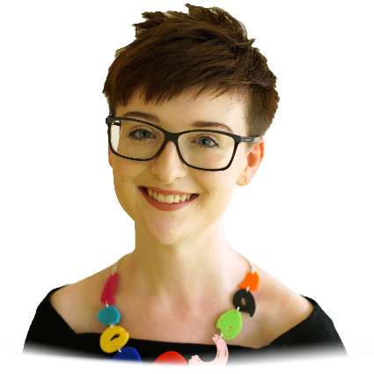
Thanks for coming and all the very best for your year as a course rep!
Liam Jackson - Education Officer education@warwicksu.com
Maisie Hicklin - UG Academic Voice Coordinator
Maisie.Hicklin@warwicksu.com
Emily Dunford – Postgraduate Officer postgrads@warwicksu.com
Nathalie Key – PG Academic Voice Coordinator Nathalie.Key@warwicksu.com
sslc@warwicksu.com
warwicksu.com/sslc

