Slide 1

Warwick Students’ Union
An Introduction To
Society Finances

Slide 2
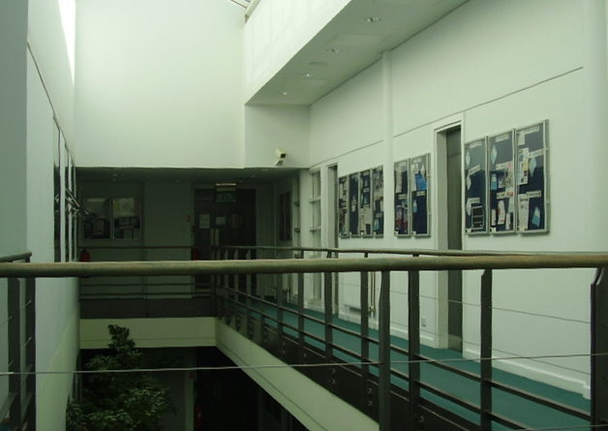
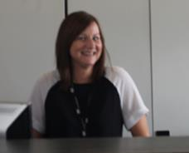
The Finance Office
Located on 2nd floor of SUHQ
Open throughout the year
Monday – Friday, 10.00am – 3.00pm
Contact us: finance@warwicksu.com

Slide 3






We Are Not The Fun Police!
We’re here to help make the running of your society as straightforward as possible…
 We are not here to confuse you about finance
 We are not here to tell how to spend your money
 We are not here to confine or curtail your activities
BUT…
Society activities must be legal and compliant…

Slide 4
Warwick Students’ Union
UK registered charity, number 1136894
Charitable company, number 7297865
Memorandum & Articles of Association
Outlines the purpose of the Union and how it’s administered
Ultra vires – ‘beyond power’
The SU – and its societies & sports clubs – must work within the Objects outlined in Section 4 of the M&A

Slide 5
SU Societies
A society…
is an unincorporated charitable membership organisation
is affiliated to, and subject to, the SU’s constitution, by-laws, policies & financial regulations
must have a President, a Secretary and a Treasurer
A society is NOT a small business with the aim of generating lots of profit or cash!

Slide 6

The Society Treasurer
How To…Be A Society Treasurer!
Download the role description from Exec Resources
SU Financial Regulations
FP12 Clubs & Societies and FP14 Charity Collections
Monitor funds and ensure they are spent for the benefit of members, keep on top of paperwork and communicate regularly with Exec & members
REMEMBER: I’m an accountant so you don’t have to be…

Slide 7
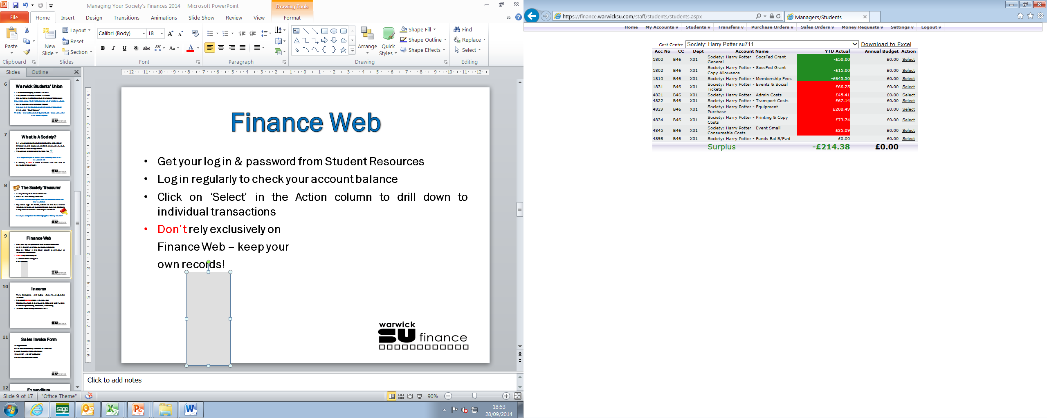
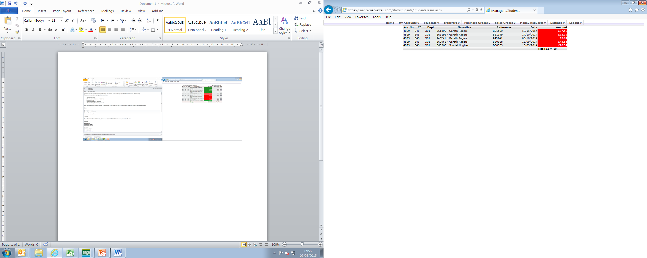
Finance Web
Get your log in & password from your Society Co-ordinator
Log in regularly to check your account balance but…
don’t rely exclusively on Finance Web – keep your own records
Click on ‘Select’ in the Action column to drill down to individual transactions

Slide 8
Finance Forms
Money Request – Purchase Order – Sales Invoice
Please ensure forms…
are complete, accurate and legible
are authorised by an appropriate member of the Exec
include supporting documentation / invoices / receipts
are handed in at the Resources Room
are submitted in time for us to process to any deadline
Blank forms can be downloaded from Exec Resources

Slide 9
Coding Structure
Account code – Society Cost Centre – Department Code
Income codes always start with 18**
Highlighted in GREEN on Finance Web
Expenditure codes always start 48**
Highlighted in RED on Finance Web
An account code list will be emailed to you with a copy of this presentation

Slide 10
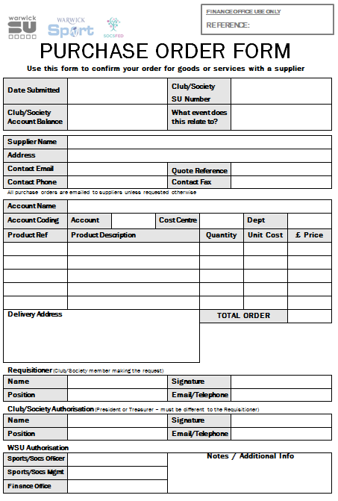
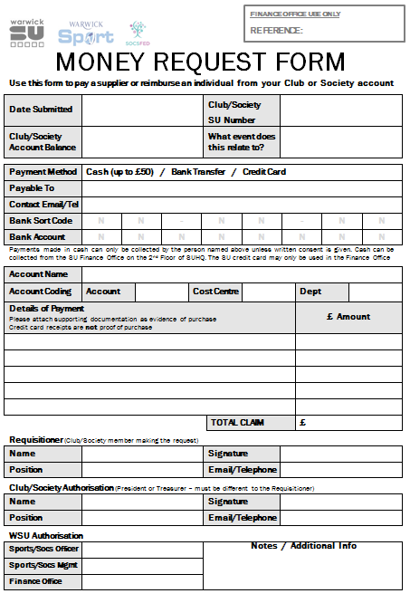
Expenditure
Members’ funds should be used
to benefit members
MRF or PO?
MRF to make a payment now
PO to confirm an order but pay later
No funds = no payment

Slide 11
Who & How To Pay
Members
Registered Companies
Non-Members
Self-Employed
Partnerships
MRF
CASH
Up to £50 from Finance Office Counter
Turnaround:
3 days*
BACS
Sort code & account number
Turnaround:
5 days*
Foreign BACS
BIC & IBAN
for EU & EEA
BIC & account number outside of EU/EEA
Turnaround:
Min. 5 days*
Credit Card
Use the card in the Finance Office
Cannot use PayPal or Amazon
Turnaround:
3 days*
* Turnaround times may be longer during vacation

Slide 12

U T Arghhh!
If your supplier isn’t a registered company they will need to provide us with a letter to confirm that they are registered with HMRC before we can make payment
UTR – Unique Tax Reference: the 10-digit number given to anyone who registers for self-assessment
Students are not exempt from paying Income Tax!
Don’t try to circumvent the system by making a payment directly to the supplier

Slide 13
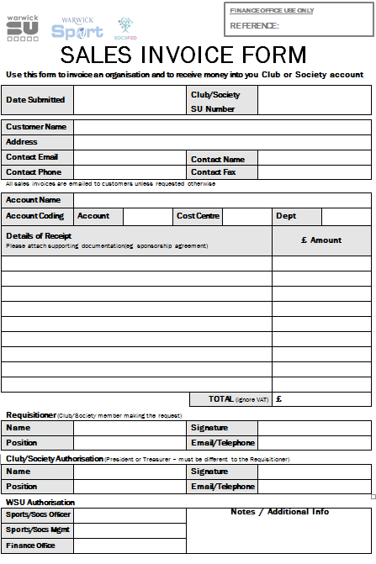
Income
Think strategically – and legally – about
how you generate income
Remember societies cannot trade
– it’s ultra vires

Slide 14

Paying In Money
Cash or cheques to bank?
Deposit with the Finance Office ASAP
Cheques payable to ‘WSU’
Charity buckets
Nominated 15 charities only

Slide 15
A Few More Things…
VAT
Societies aren’t VAT registered so don’t worry about it!
Insurance
Societies have no personal accident cover (sport clubs do!)
No cover for loss or theft of society money in your possession
Film screenings
Do you need a licence? Check BBFC website www.bbfc.co.uk
Raffles, tombolas & sweepstakes are all types of lottery
Gambling Act 2005 applies

Slide 16
Further Help & Advice
George Creasy, Societies Officer george.creasy@warwicksu.com
Gerard Henry, Student Activities Manager gerard.henry@warwicksu.com
Marcus Boswell, Societies Co-ordinator marcus.boswell@warwicksu.com
Meg Digweed-Davies, Societies Co-ordinator megan.digweed-davis@warwicksu.com
Indy Sanghera, Societies Co-ordinator indy.sanghera@warwicksu.com
Jacqui Anderson, Deputy Finance Manager jacqui.anderson@warwicksu.com
02476 572810

