Slide 1
Exec Handover Day Introduction
George Creasy
Societies Officer

Slide 2
Agenda For The Day
11:00 - 11:15 Introduction
11:15 - 12:00 Opening Keynote - Building Blocks to a Successful Year
12:00 - 13:00 Break Out Sessions: Finance, Equality and Diversity, Event Planning
13:00 - 14:00 Lunch and networking (Free Bread Ovens #Scenes)
14:00 - 15:00 Planning / Q & A with Socs Exec

Slide 3
First things first - Congratulations!!!
You have all won an election to represent and put on events for dozens, maybe hundreds, or possibly thousands of people.
We have ~1,500 society execs and ~500 sports clubs execs - so you're all in the top 10% of students at this university in terms of extra curricular activities
But the hard work starts now! The role on your CV in itself is pointless without a bunch of anecdotes of all the work you put in and stuff you achieved throughout the year.

Slide 4
Introduction to the University
Warwick University's turnover is over £500 million a year
>24,000 students from over 140 countries
>5,000 staff
30 academic departments in 4 faculties: Arts, Social Sciences, Science and Medicine
553 hectare campus
Warwick are planning on constructing a new building every year for the next few years (Starting with the Teaching and Learning Building on Tocil Field set to open next year)

Slide 5
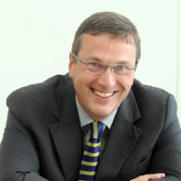
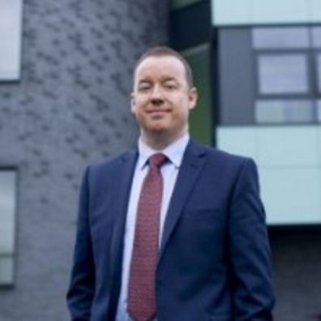
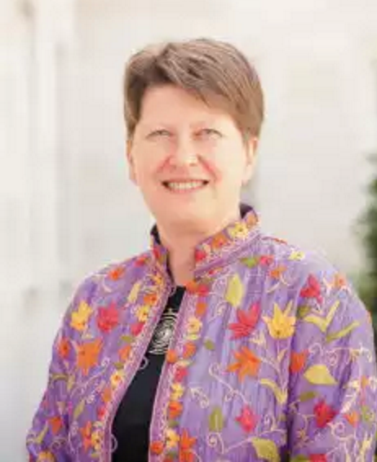
BNOCs
Stuart Croft is the newly appointed Vice Chancellor, so he is the CEO of Warwick University and chairs University Council (The highest decision making committee of the University)
Ken Sloan is the outgoing Registrar and COO of the University (The person who runs everything that isn't academia - so accommodation, retail etc (replacement TBA)
Christine Ennew is the incoming Provost (replacing Stuart), and is effectively deputy VC, she will oversee all things academia.

Slide 6
The University are only just starting to recognise the importance of the work that societies and sports clubs do on this campus - so it's a really exciting time to be on an exec, with the potential for much more publicity and funding

Slide 7
Introduction to Warwick SU
We are a registered charity which exists to improve the experience of Warwick University students
Turnover is about £8 million a year
We have a board of trustees - the highest decision making committee of the organisation. Made up of sabbs, lay trustees and student trustees (who we're currently recruiting for! Check the website…)
We have 7 sabbatical officers, 12 part time officers, a student council and 8 SU execs

Slide 8
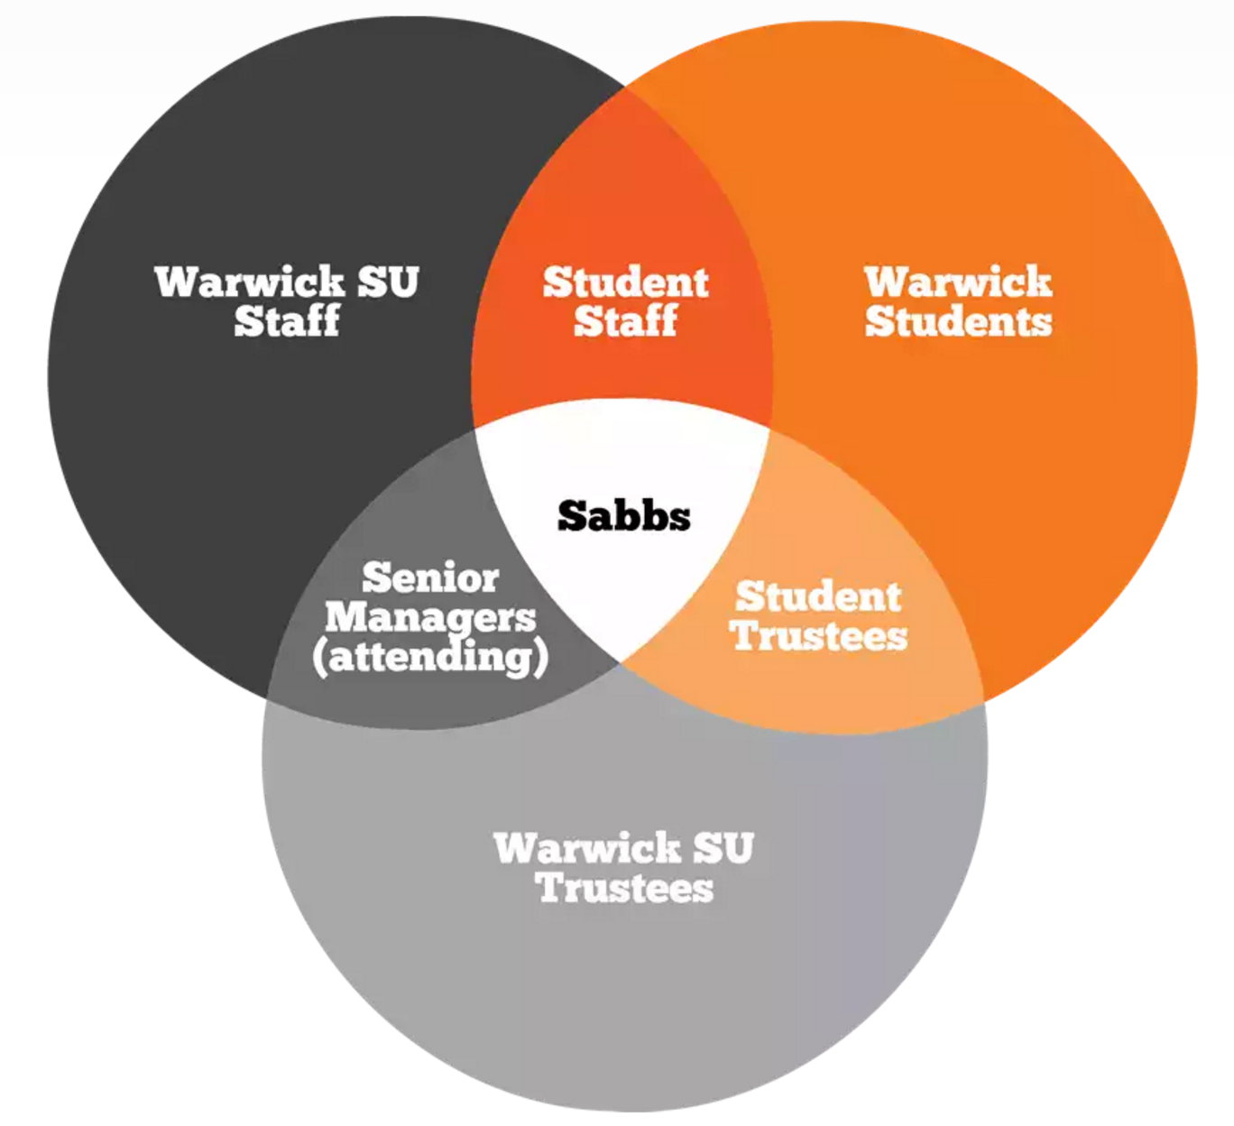
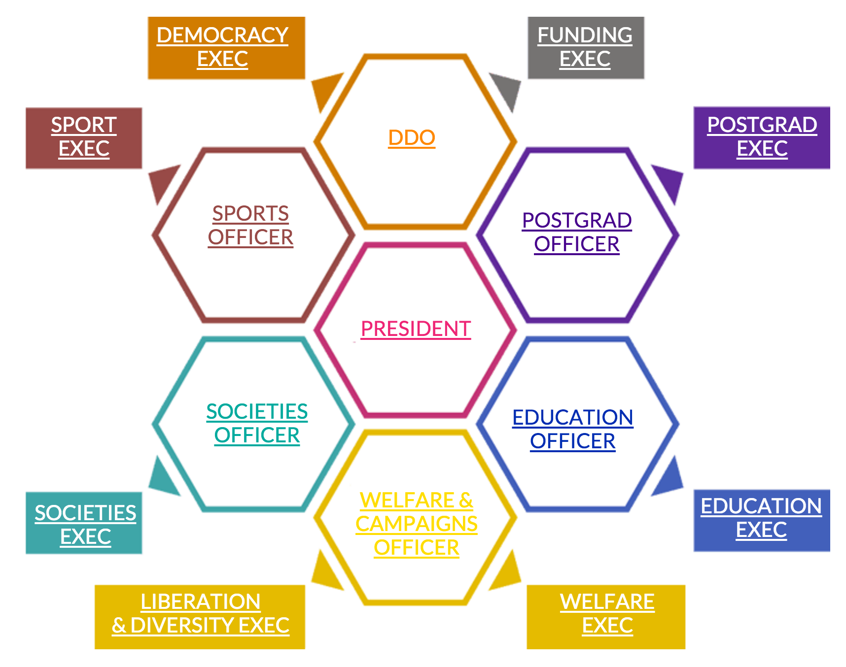
Warwick SU

Slide 9
What Societies Do
2015/16 numbers:
Number of individuals in societies: 10,242
20 conferences with budgets totalling over £250,000 and 5,220 tickets sold
31 balls with budgets totalling over £250,000 and 4,310 tickets sold
42 tours with budgets totalling over £250,000 and 1,418 tickets sold
£65,000 raised for charity in term 1 alone (Nearly £1,000 a day on average)

Slide 10
What Makes Warwick Societies so Great?
DISCLAIMER: This is only my theory.
We have the best students in the country - smart, innovative, dynamic, creative, talented. Basically: Book smart and real world smart.
Exec roles make you employable, and are hence very competitive, which means manifestos have to be better every year, which leads to incredible growth in what societies do.
We reinvest >£65,000 of the SocsFed fees back into societies every single year (information on how to apply in the finance b/o session later)
Notes:
This is what makes the SU such an incredible place to work - the rate of progress, the rate of growth, it is unlike anything seen anywhere else because of the nature of how it is run.

Slide 11
This is where you come in
What will you do with your year?
It won't be easy - juggling a degree with an exec role is hard work - but it will pay off in the long term if you're willing to put in the work
REMEMBER: It's not all about numbers - in fact we're at saturation point now where attendances aren't going to increase any more
It's about quality, not quantity. Work hard, collaborate and give your members real value for money, and an incredible student experience.

Slide 12
Building Blocks to a Successful Year
George Creasy
Warwick SU

Slide 13
Contents
Meet The Team
Roles & responsibilities
Timeline for the next year
Planning
How do I actually do anything?
How to get Funding
How to Publicise stuff

Slide 14
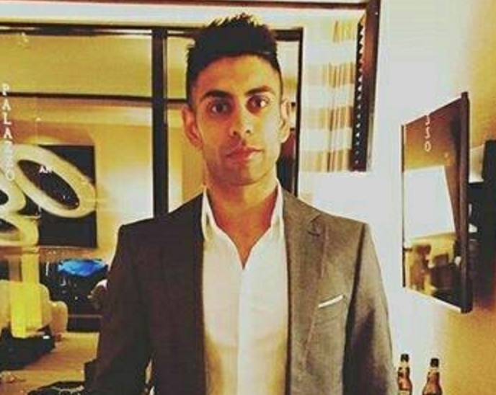
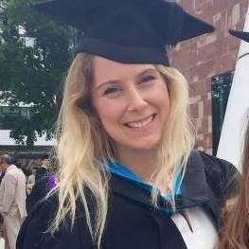
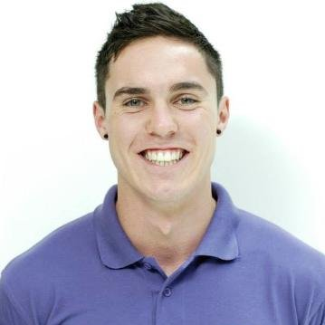
Meet The Team - Societies Co-ordinators
Indy Sanghera
Academic
Religious and Belief
Music Appreciation
Megan Digweed-Davies
Film and Media
Halls of Residence
Performance
Welfare, Charity, Action
Campaigning
Conferences
Marcus Boswell
Cultural
Activities and Games
Food and Drink
Balls
Trips & Tours
Ticketing
If you haven't met your co-ordinator yet, then find them and introduce yourself!
They are there as your admin support, so any questions - ask them!
These are the people that you hand your forms into - money request forms, external speaker forms etc…
Set up meetings with them to plan your year - they have the knowledge from previous years and know how the SU works - utilise them
They work 8:30am-4:30pm (3:30pm on a Friday) - so don't expect a reply in the evenings!
*Subject to change for the next academic year

Slide 15
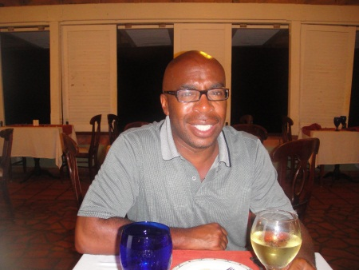
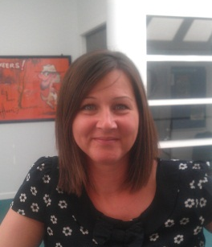
Meet The Team
Gerard manages the co-ordinators so if they don't know the answer to something, they'll go to Gerard
Paula is there for all things money related - although you hand MRFs into your co-ordinator, go straight to Paula to deposit/collect/spend money
Gerard Henry – Student Activities Manager
Big trips and tours
Risk management
Problem Solving
Sponsorship
Insurance
Paula Thomas - Finance Counter Assistant
Deposit money into society accounts
Collect money for reimbursement
Gatekeeper of the Union Credit Card
Located in the Finance Office (2nd Floor of SUHQ), 10am-3pm weekdays.

Slide 16
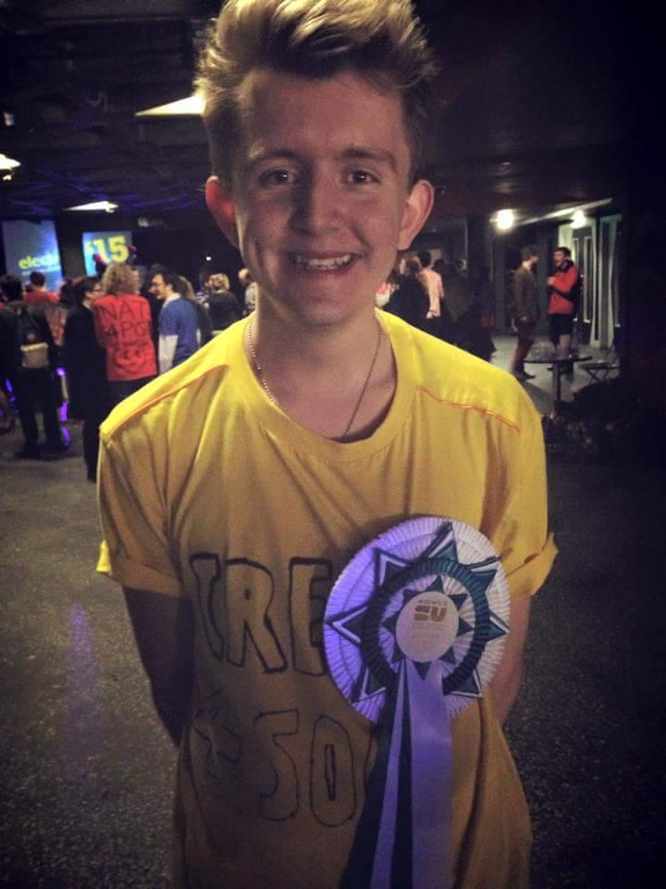
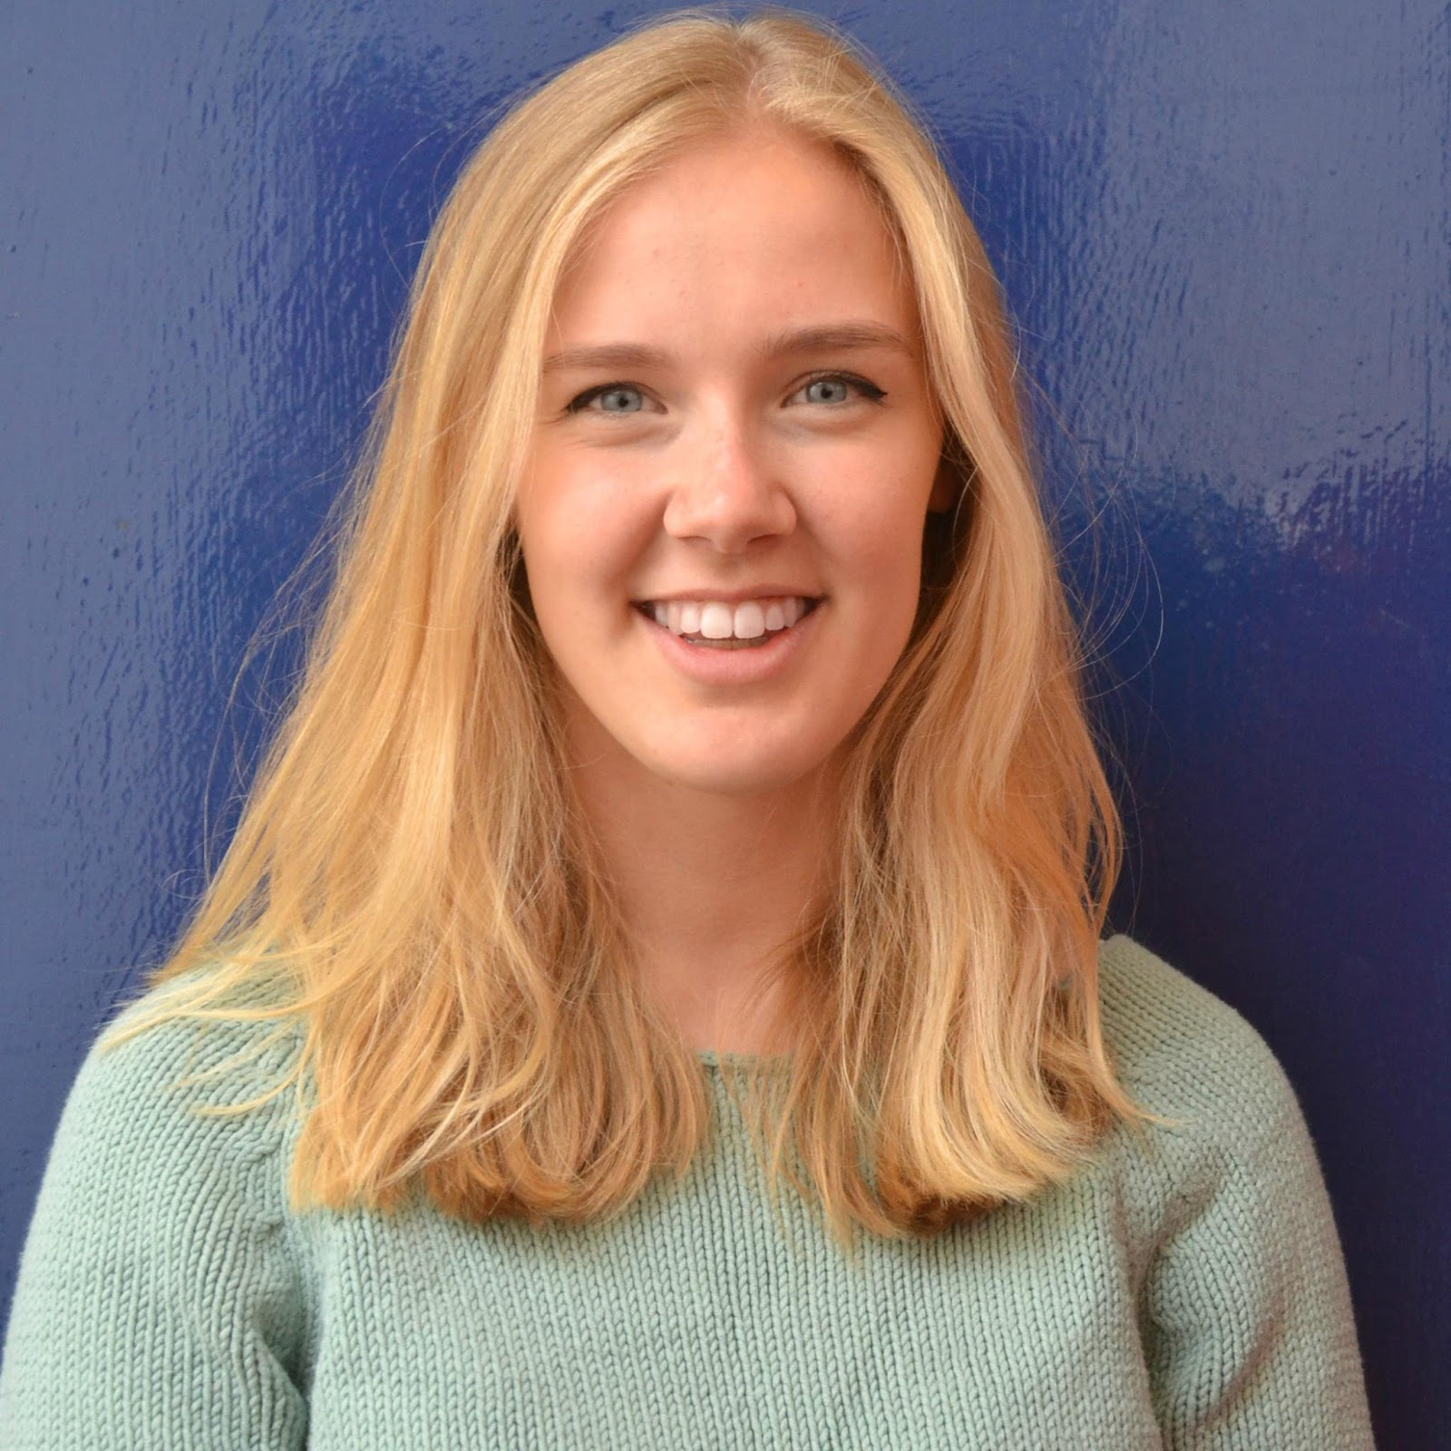
Meet The Team - Your Sabbatical Officer
George Creasy - Societies Officer
The student face
Strategic thinking of the Union and University
Problem solving
Support, train, advise and guide
Marketing and Publicity of events
Careers & Skills
Arts Centre
Funding
Marissa Beatty - Societies Officer-elect
Will take office from 1st August 2016.
I'll be giving Marissa a comprehensive handover in July, but she doesn't officially start until the 1st of August - so contact me until then!
Feel free to set up meetings to discuss strategy and planning
Feel free to invite me to an exec meeting if you think it would be beneficial to have me there in a tough discussion
Come to me with positive stuff - not just problems!

Slide 17
The Resources Room
Find it on the 2nd floor of SUHQ
This is your room – don’t knock, just enter!
Use it for exec meetings, for designing posters, for being creative, and for filling out and submitting forms.
Use the computers in there (or there are a couple downstairs in the lounge) - you can print directly from society money on your society logins.
Get to know the staff, they are here to support you however they can!

Slide 18
Charity Law
The Union is a registered charity, and as such we are bound by Charity Law.
As societies within the Union, you too are bound by the same law, and should see yourselves as “mini-charities”.
The money in your accounts is charitable money and should be spent according to your primary purpose to benefit all of your members equally.

Slide 19
What Does This All Mean?
Can’t spend hundreds of pounds of society money on champagne or grandiose meals in fancy restaurants
This would be like Cancer Research spending all their money on Domino's Pizzas
Can’t spend a disproportionate amount of money on a minority of people, i.e. no freebies for execs
This would be like Cancer Research spending all of its money providing support for just the Trustees’ families and no-one else.
Money spent on food and alcohol cannot be excessive

Slide 20
What Does This All Mean?
Societies can NOT trade
Your society funds are donations not revenue.
Consequently, you can't put on events to run at a profit. You are simply running events to break even at 65% attendance.
Any fundraising we do has to be processed through RAG's account (Because otherwise it is illegal for a charity to give money to another charity)
There is special dispensation for this in the Charities Act, 2011.

Slide 21
Constitutions & Primary Purpose
Your primary purpose is your aims and objectives as set out in your society's constitution
Every society has one - if you can't find a copy of yours then ask in the resources room and we'll find you a copy
Therefore any money that is being spent on something that isn't within your aims and objectives, or the SU's primary purpose (to improve Warwick students' experience of university) is illegal.
This is why we require events to have at least 80/20 balance of Warwick students to externals.

Slide 22
Legal Responsibilities
You are all legally responsible for your members on events and socials.
If there was an incident, you would be responsible for the students involved in a Court of Law.
You therefore have a Duty of Care to all of your members. We have online Duty of Care training on the SU website under exec resources -> Training
This is also why we require risk assessments to be filled out with all event planning packs, to demonstrate that you have thought about and minimised any risks involved in your events.
This means that on nights out that it is the exec's responsibility to make sure members get home safely - especially freshers.

Slide 23
When do I need to fill out an event planning pack?
You need to fill out an event planning pack if there are any of the following associated with the event you plan on running:
Financial risk - If you're selling tickets to an event, with the risk of not selling enough
Reputational risk - If you're inviting external speakers onto campus, or doing anything that the media might write about
Health & Safety risk - If you're organising a trip to laser tag, then we'll need to see a risk assessment
If you're just holding a social in curiositea or organising a night out, then you don't need to fill out a pack!
Notes:
Drama society putting on plays

Slide 24
Legal Responsibilities
You are all covered by the Union’s Public Liability Insurance (paid for by the SocsFed fee)
What does this mean?
If a mirror ball fell from our ceiling and injured one of your members, then you as an exec member would not have to pay the legal costs associated with that claim.
However there is absolutely no cover for personal accidents.
What does this mean?
If one of your dancers broke their leg in a rehearsal, then they are not covered by any of our insurance.
You will need to make your members aware of this, and they will need to purchase their own travel/accident insurance for any trips and tours.

Slide 25
Roles & Responsibilities
This isn't supposed to scare you all! But with great power comes great responsibility.
And we are here to help you every step of the way! As long as you comply with all SU processes like event planning, and you get all of your forms into us with plenty of time, then we wouldn't let you open up yourselves to any risk
Worried about anything? Just ask - me, Gerard, the co-ordinators - we are all here to help!

Slide 26
External Speaker Forms
I just want to emphasise that last point in regards to external speaker forms.
We require external speaker forms to be in >28 days before the event - this is required so we can do the necessary research into the speaker
We don't ban speakers - as long as we have enough time, we will facilitate anyone
If you are putting on an event with a controversial speaker or topic, then please let us know as soon as possible.
We can be flexible at times, but we reserve the right to stop events from happening if we don't have enough notice

Slide 27
Timeline - Term 3 and Summer
Handover meetings with previous exec
Get sponsorship packs out to companies over Easter if you're looking for external sponsorship (George/Gerard can provide assistance on this)
Plan your year as exec, when are events, socials, deadlines etc
Budget for the year ahead - so no nasty surprises!
Get all event planning packs in for term 1 events
Planning for Freshers’ Week and societies fair – how can you stand out? (Make sure your publicity is ordered to the SU in time for freshers week!)

Slide 28
Timeline - Term 1
Freshers’ Week & Societies Fair (Week 1)
Societies Convention (Week 1)
Skills Hub Training! (TBC)
Opportunity Fund/VC Fund goes live (TBC)
Sourcing venues for balls / trips / large events (Term 1)
Ball Planning Pack deadline (Week 8)
Tours Planning Pack deadline (Week 8)

Slide 29
Timeline - Term 2
Convention
Last chance for Lord Rootes Funding and Opportunity Fund
Applying for new budgets
Execute balls, conferences, trips and tours
Society Award submissions – start thinking!
Refreshing sponsorship packs/proposals
Collating information for exec handover
Elections

Slide 30
Planning - Activity (5-10 minutes)
Week | Activity
1 | Freshers fair
2 | Meet & Greet social
3
4 | Social - collaborative night out
5 | Halloween event
6
7 | Social - non alcoholic
8
9 | Speaker event
10 | Christmas meal
In Student Activities we're all about forward planning, the earlier you can come to us with things, the better.
So take 5 minutes either by yourself, or with your fellow exec members now and start mapping out the next 12 months for your society on paper or on your phone/laptop
When are your big events? When will you have socials?
The sooner you and your exec can map out your year, the sooner you can start filling out event planning packs/ booking rooms/ acquiring funding/ publicising stuff to your members
Who could you collaborate with?

Slide 31
How to Actually Do Stuff - Exec Resources
We're currently still updating all of our pages to the new website redesign - so currently exec resources is spread across these two links:
www.warwicksu.com/execresources
www.warwicksu.com/societies/execresources
Hopefully by the time I've handed over to Marissa, everything will be updated and on the latter link
This is your go to place if you have a question - only if you can't find an answer on here do you ask a co-ordinator/the socs officer

Slide 32
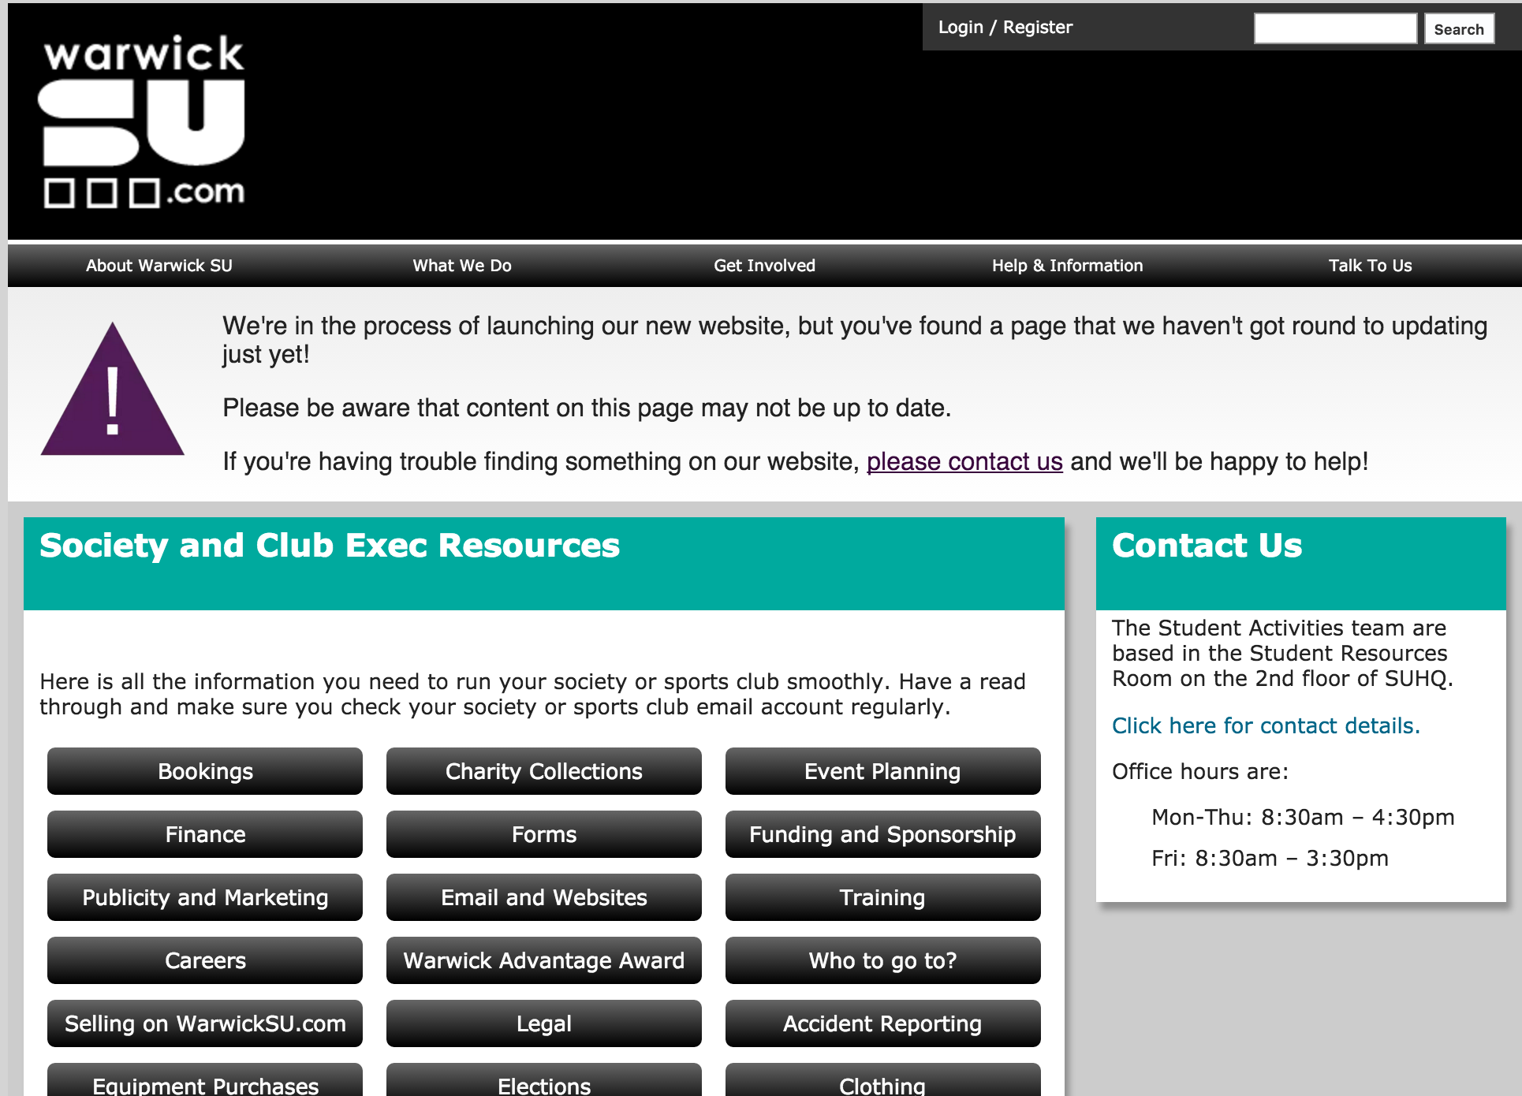
Exec Resources

Slide 33
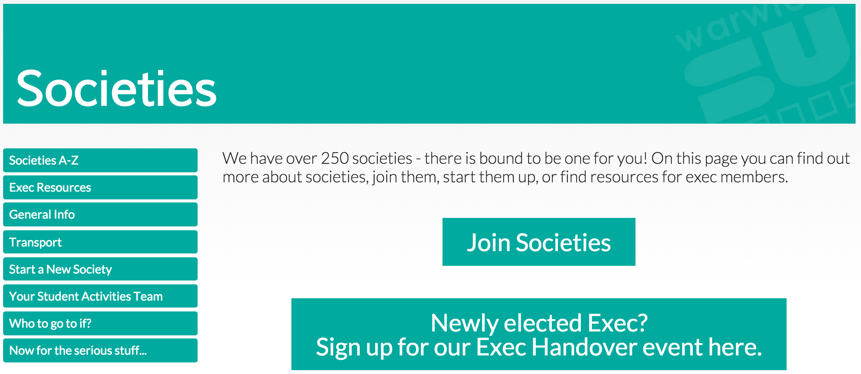
Exec Resources

Slide 34
How to Actually Do Stuff - Admin Rights
This is how you check membership numbers, send emails to all of your members, create events, check your finances etc
To have this access - you need to have handed in updates exec sheets to the resources room, either in person or digitally to studentactivities@warwicksu.com (The form can be found on exec resources)
Updating your exec sheets will also mean you'll receive my weekly SocsFed emails with all of the society related news you could ask for.

Slide 35
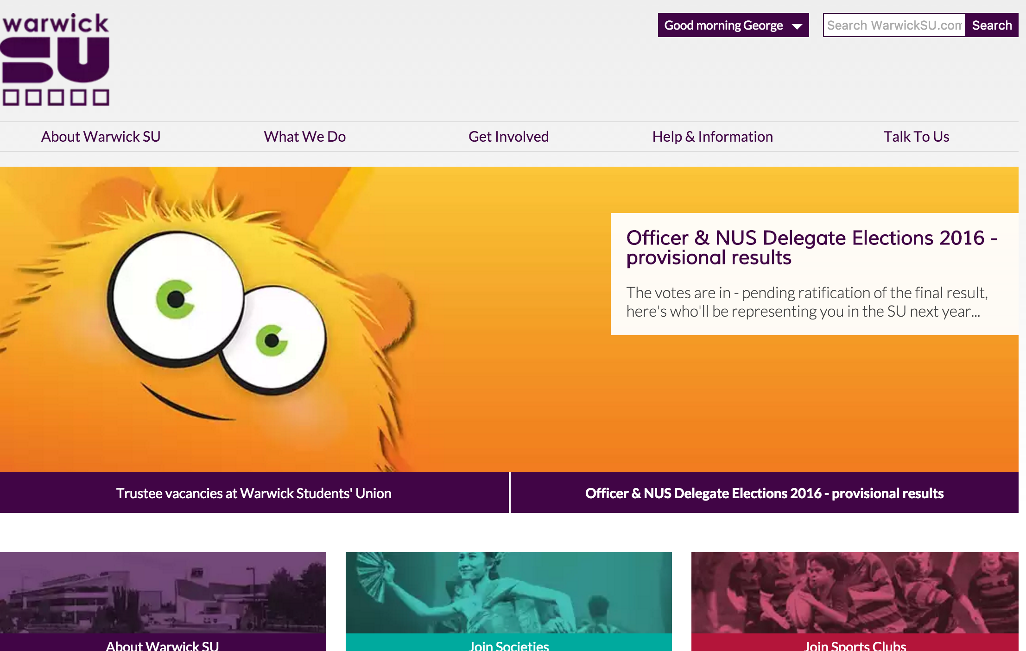

Slide 36
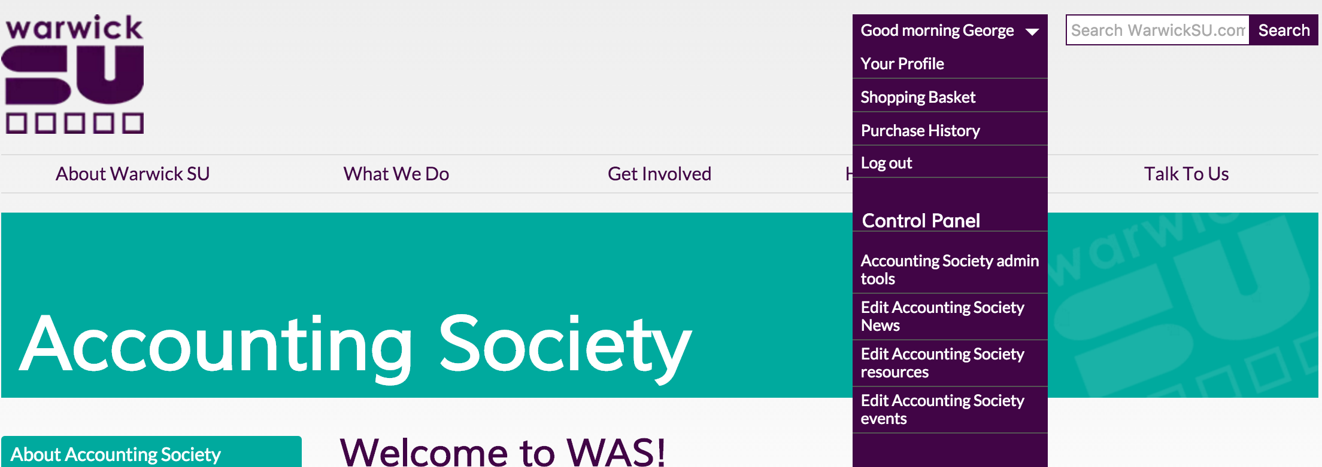

Slide 37
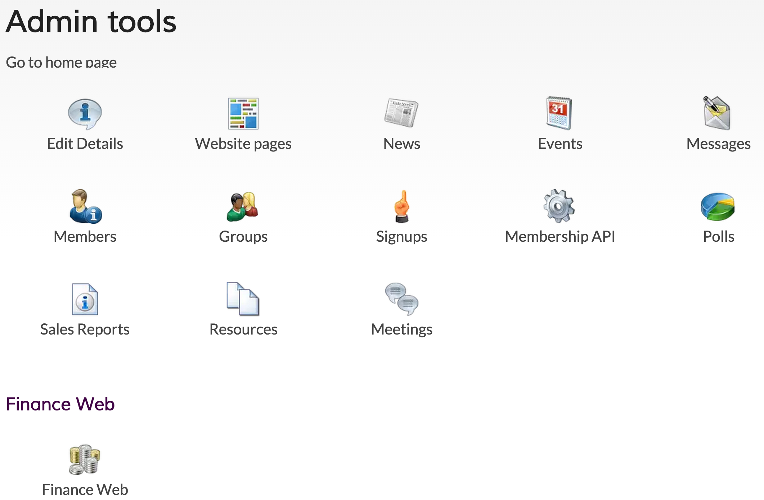

Slide 38
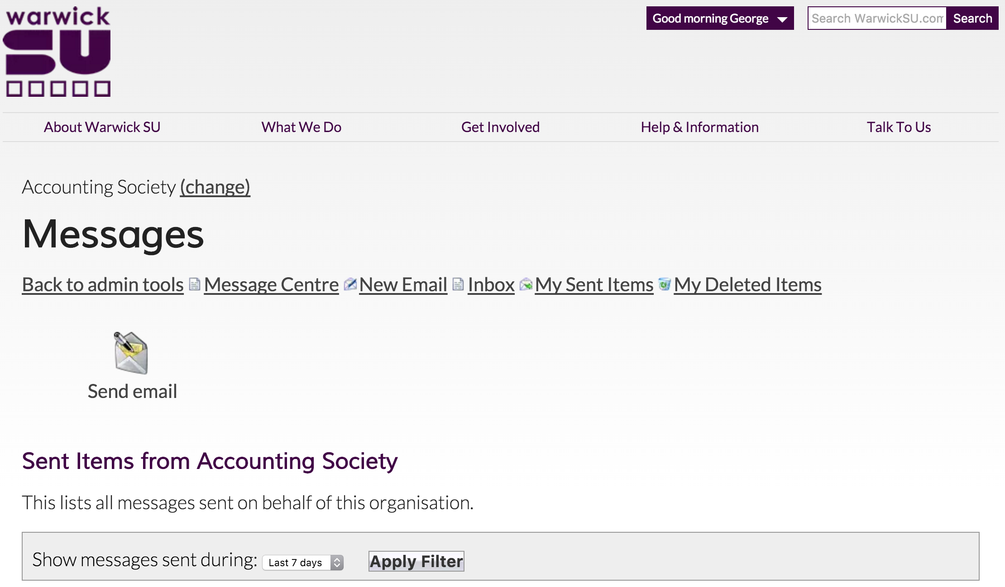

Slide 39
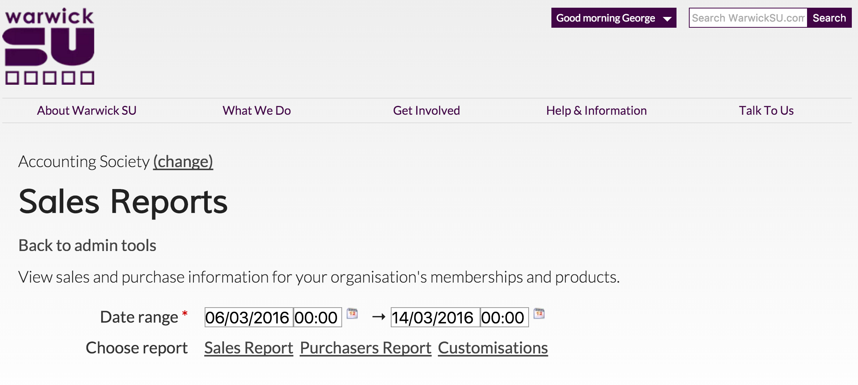

Slide 40
Your login should have been handed over - if not then just ask your society co-ordinator (that login also gets onto computers in the SU

Slide 41
That's it for SU stuff
Hopefully your society has a Google Drive/ Dropbox/ Facebook Group full of emails, pictures and files which has been handed over to you.
(If not - probably make one?)
Most societies use the SU's interface to send all member emails, but their own gmail account to deal with external sponsors, or queries from members.

Slide 42
How To Get Money From SU Funds
SU Funds:
Project Fund:
Environmental Sustainability Fund:
Campaigns Fund:
SocsFed Emergency Fund (Hopefully you won't need this!)
SU Grant (more info in finance B/O session!)
All the information you could possibly need about these funds is on this page:
http://www.warwicksu.com/democracy/howitworks/execs/funding/
For more information, email either me at societies@warwicksu.com or Olly Rice at democracy@warwicksu.com

Slide 43
How To Get Money From External Sources
University Funds:
VC Fund: To fund proposals that demonstrate real impact on Warwick students
GoGlobal Grant: To fund groups who wish to celebrate internationalisation. (Rolling)
Opportunity Fund: Help to fund extra-curricular activities (Deadline 8th Feb)
Lord Rootes Memorial Fund: For one off events (Deadline this Thursday!)
All the information you could possibly need about these funds are on these pages:
http://www2.warwick.ac.uk/services/vco/vc/studentsupport/
http://www2.warwick.ac.uk/giving/thanks/stories/opportunity-fund/opportunityfund/
http://www2.warwick.ac.uk/study/international/students/goglobal/grant/
http://www2.warwick.ac.uk/insite/topic/teachinglearning/rootes/

Slide 44
How To Get Money From Sponsorship
PDFs of no more than 4/5 pages
Big Societies - Look at the Times Top 100, Guardian Top 100
Smaller Societies - Contact local businesses/bars/restaurants
Industry leaders (not necessarily top graduate employers) sometimes more appropriate
It's not all about money - what else could a sponsor give you? Speakers? Workshops? Swag?
Sell yourselves! Think about your USPs and what you can do for THEM.
We will be holding a sponsorship information sessions - watch this space
Email me at societies@warwicksu.com if you need any guidance
Notes:
RaW have a very good one online on their website - check that out

Slide 45
Basically, there is loads and loads of money available here, all you have to do is go and get it. So if you have an idea or a project that you want funded, come to me and I can steer you in the right direction and advise you every step of the way.
Notes:
WIDS example?

Slide 46
#AllTheLinks - Publicity & Marketing
Publicity & Marketing:
SU Screens: holly.smith@warwicksu.com
Chaplaincy Screens: outdoorscreens@warwicksu.com
Big Screen: http://www2.warwick.ac.uk/services/externalaffairs/marketing/digital/signage/digitalsignage/bigscreenpiazza/submission/
Student Media (See their websites for more information!):
The Boar: Advertising - sales@theboar.org Stories - news@theboar.org
RaW 1251AM: marketing@radio.warwick.ac.uk
Warwick TV: exec@tv.warwick.ac.uk
Warwick Student Cinema: advertising@filmsoc.warwick.ac.uk

Slide 47
#AllTheLinks - Bookings
SU Meeting Rooms: lesley.shortland@warwicksu.com
Union Venues: lesley.shortland@warwicksu.com
University Rooms: www.go.warwick.ac.uk/roombooking
Any Sports Facilities: sportsales@warwick.ac.uk
Outdoor Spaces (including Piazza & Plaza): https://www2.warwick.ac.uk/services/retail/piazza/application/
Humanities Studio: http://www2.warwick.ac.uk/fac/cross_fac/iatl/resources/spaces/
Flexigrid: http://www.warwicksu.com/execresources/cafeteriabooking/
If you need a room for a certain event/performance and you don't know - Just ask me!
Hopefully between me and the team, we can find somewhere that suits what you want.

Slide 48
#BestPracticeTips
I recently put together a document full of some best practice tips from what I've seen societies doing particularly well.
Here's the link to said document: https://docs.google.com/document/d/1dJ9Gk15aYCiFYwY8NXPfWg2csASG9qX_1aeTpPbSlg4/edit?usp=sharing

Slide 49
Any Questions?

Slide 50
Break Out Sessions: 12:00pm-13:00pm
• Finance (Treasurers & Money related roles) MS.02
• Event planning (Event co-ordinators, Ball/Tour co-ordinators) MS.04
• Equality & diversity (Social secs and anyone else) MS.05
Come back here after for lunch!

Slide 51
Lunch and Networking
Questions you could ask:
What Society are you from?
What have you got planned this term?
How does your exec work? (Meetings, communication, technology)
Could we collaborate in the short term? (Bring members to each other's events)
Could we/you perform, report on, record or publicise an event?
Could we work together to create a charity sports tournament in 2016? (euros+olympics!)
Could we collaborate in the long term? (Co-host a conference/ball/tour next year?)

