Slide 1
Event Planning
A guide to running stress free events

Slide 2
Event Planning Basics
If you’re running a major event, it needs to be authorised by the SU.
This includes:
Balls
Trips/Tours
Conferences
Any event where you’ll need society funds to pay for things
You need to fill out an Event Planning Pack (Event Planning Form, Risk Assessment & Financial Planner).
Warwick SU > Societies > Exec Resources > Event Planning

Slide 3
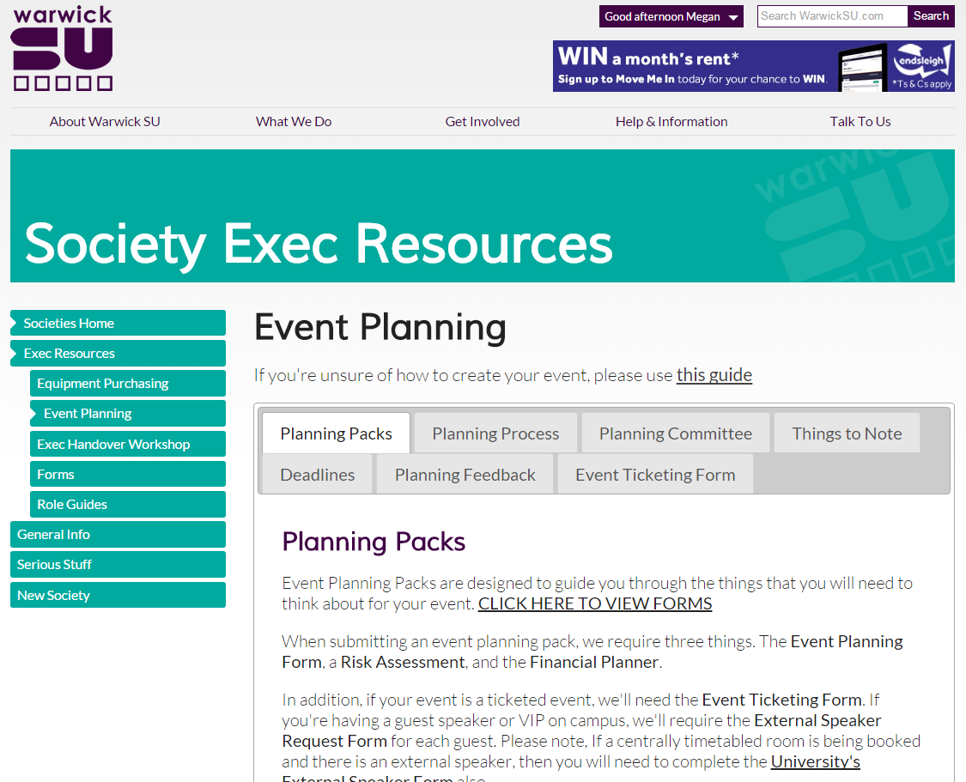

Slide 4
When is a Planning Pack required?
We don’t need packs for everything. For example:
Basic socials
Events where you’re not using society money
Movie nights at a friends house
After party take-away at a local kebab
We have had planning packs for this in the past…

Slide 5
Planning Overview
Submit a planning pack to us at least 4 weeks before the event. Longer for big events, balls, tours
We will invite you in for a 5-10 meeting to go through the event to clear up any queries.
Either it will be signed off and you can go ahead…
…Or we’ll ask for some tweaks or more info before we sign it off.

Slide 6
Before the Event
If you’re unsure of anything, just ask us!
We’d rather help you with filling in the packs, planning events, finance queries, etc.
Don’t give us packs days before an event. Give us a chance…
Come see us in the Resources Room of SUHQ, or email me at Indy.Sanghera@warwicksu.com.
I will either respond myself or forward you to the relevant coordinator.

Slide 7
Questions?

